Slide 1
A Corporate Accounting and Reporting Standard
Training Curriculum

Slide 2

Lesson Modules

Slide 3

Operational Boundaries
Lesson 4

Slide 4
Learning Objectives
In this lesson, you will learn:
Which sources of emissions to include in an inventory
The difference between direct and indirect emissions
How to classify emissions under Scopes 1, 2, and 3
How to prevent double-counting emissions
How to classify emissions from leased assets

Slide 5




“Boundaries” in a GHG inventory
Boundaries: Imaginary lines encompassing the emissions to include in a company’s GHG inventory
Organizational boundaries
Determine which company operations to include
Operational boundaries
Determine which emissions sources to include
Determine how to categorize emissions
Scope 3
Scope 1
Scope 1
Scope 2
GHGs
GHGs
GHGs
GHGs

Slide 6
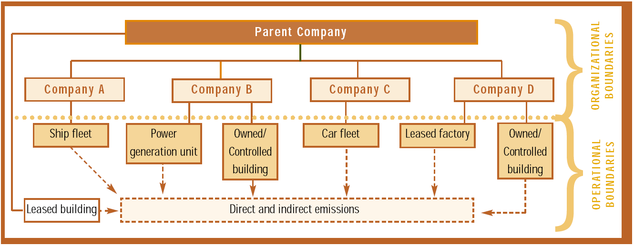
Organizational and Operational Boundaries

Slide 7
Why are Operational Boundaries Important?
To determine which sources of emissions to include
To classify sources to avoid double-counting
To provide more useful information to stakeholders
To help manage GHG risks and opportunities along the value chain

Slide 8
Setting Operational Boundaries
Identify emissions associated with operations
Classify emissions as direct or indirect
Categorize the “scope” of emissions

Slide 9




Direct and Indirect Emissions
Direct: emissions from sources owned or controlled by the reporting company
Indirect: emissions that are a consequence of the activities of the reporting company but occur at sources owned or controlled by another company
Indirect Emissions
Direct Emissions
Indirect Emissions
GHGs
GHGs
GHGs
Maintenance service
(owned by another company)
Your factory
Power plant
(owned by utility company)

Slide 10
Classifying Emissions: Scopes
Direct
Scope 1
Emissions
Scope 2
Indirect
Scope 3

Slide 11
Scope 1 Emissions
Direct GHG emissions from sources a company owns or controls
Examples:
Generation of electricity, heat, or steam
Physical or chemical processing
Transportation of materials, products, waste, and employees
Fugitive emissions
Inclusion in GHG inventory: required
Scope 1
Indirect Emissions
Direct Emissions
Indirect Emissions
GHGs
GHGs
GHGs
Maintenance service
(owned by another company)
Your factory
Power plant
(owned by utility company)

Slide 12
Scope 2 Emissions
Indirect emissions from purchased electricity, steam, heating and cooling
For office-based businesses Scope 2 usually most significant
Can be reduced through energy efficiency and conservation
Inclusion in GHG inventory: required
Scope 2
Indirect Emissions
Direct Emissions
Indirect Emissions
GHGs
GHGs
GHGs
Maintenance service
(owned by another company)
Your factory
Power plant
(owned by utility company)

Slide 13
Types of differentiated electricity products
Supplier-specific emission rates
Energy attribute certificates (GOs, RECs)
Direct contracts such as power purchase agreements (PPAs), where other instruments or energy attribute certificates do not exist
Residual mix (e.g., the emissions rate left after the three other contractual information items are removed from the system)

Slide 14
NEW: required conformance with Scope 2 Guidance
New Guidance prompted by changes in electricity markets worldwide:
Deregulation
Increase in consumer choice
New purchasing options and instruments (e.g. certificates)
More government requirements for sourcing renewable energy
Growth of the renewable electricity markets
Accounting for purchased electricity should meet 5 GHG Protocol principles:
Accuracy, Completeness, Consistency, Transparency and Relevance

Slide 15
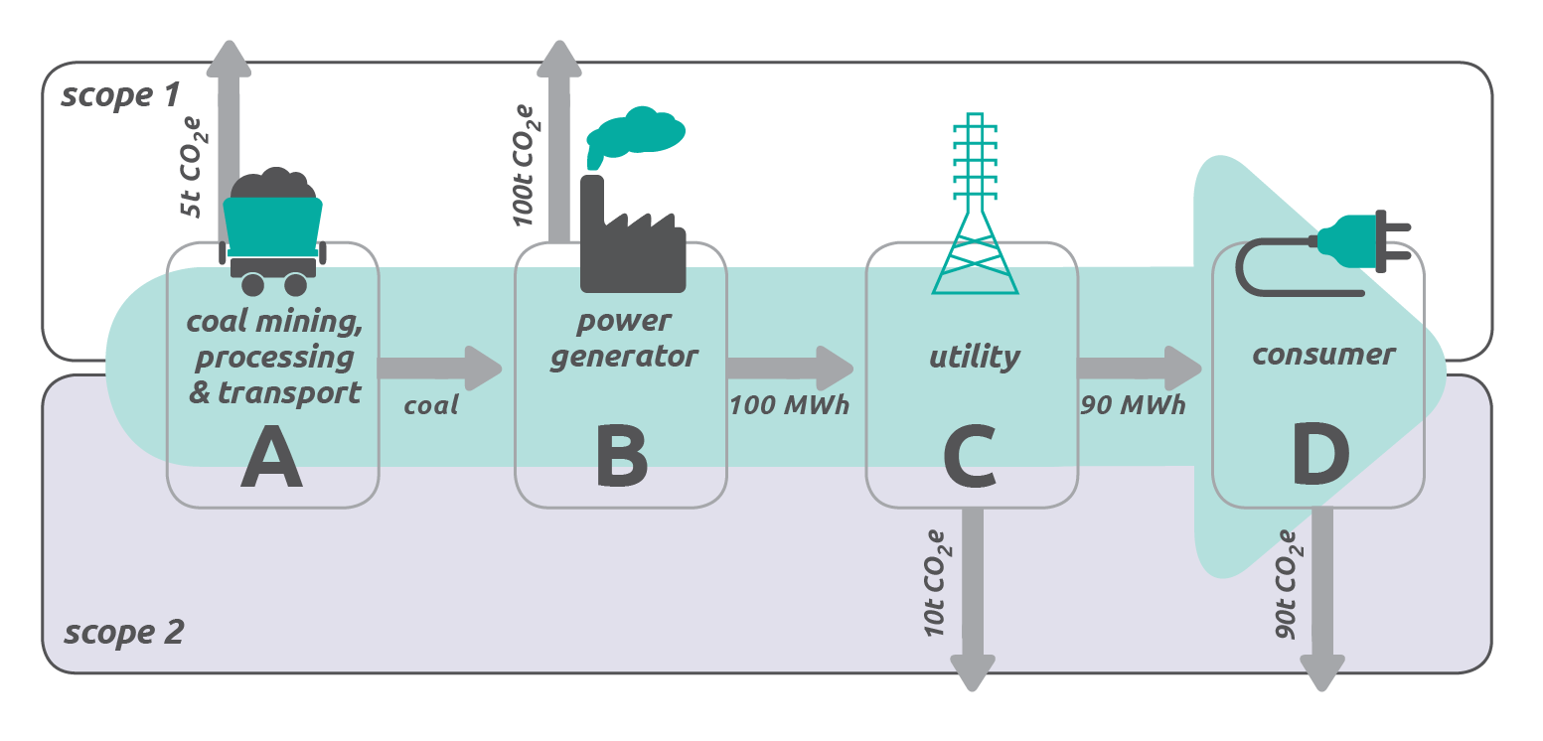
Markets with no choice in electricity supply

Slide 16
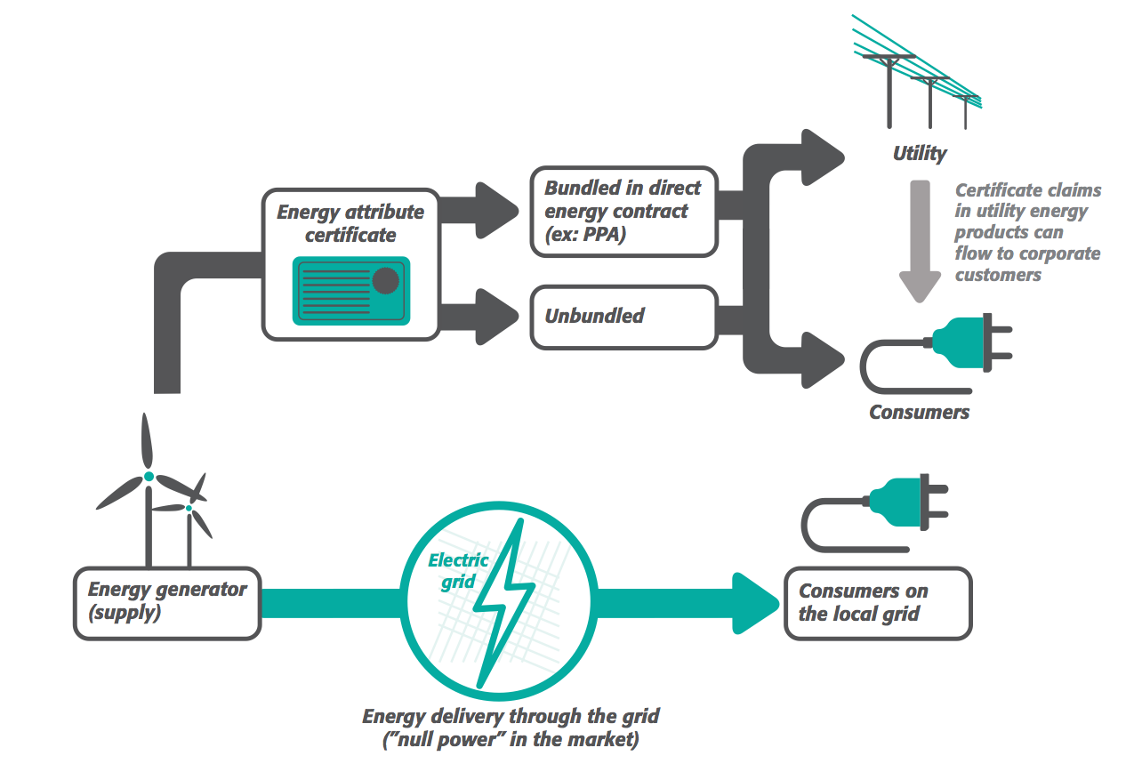
Markets with consumer choice

Slide 17
Markets with consumer choice

Slide 18
Markets with consumer choice

Slide 19
Markets with consumer choice

Slide 20
The two scope 2 calculation methods
 | Location-based | Market-based
What is it? | Reflects the average emissions intensity of grids on which energy consumption occurs | Reflects emissions form electricity that companies have purposefully chosen (via bundled or unbundled certificates)
To which markets does it apply? | All electricity grids | Markets providing consumer choice of differentiated electricity products or supplier-specific data

Slide 21
Pros and cons of the two Scope 2 calculation methods
 | Pros | Cons
Location-based method | Reflects actual generation & distribution | No incentive to reflect purchases or influence supply Only means of reducing scope 2 emissions is via consumption Less relevant for making purchasing decisions
Market-based method | Better reflects risks & opportunities associated with supplier portfolios More relevant for making purchasing decisions | Voluntary purchasing may not impact market (but see quality criteria)

Slide 22
When should the different methods be used?
For companies with operations only in markets that do not provide product or supplier-specific data or other contractual instruments:
Only one scope 2 figure shall be accounted and reported, based on the location-based method.
For companies with any operations in markets providing product or supplier-specific data in the form of contractual instruments (Currently this includes: EU Economic Area, the US, Australia, most Latin American countries, Japan, India among others)
Two scope 2 figures shall be accounted and reported, one for the market-based method and one for the location-based method.

Slide 23
Scope 3 Emissions
All other indirect emissions
Examples:
Transport in vehicles not owned/controlled by the company
Energy consumed during customer use of company products
Inclusion in GHG inventory: optional under Corporate Standard
Although may be required by some programs
Required by GHG Protocol Scope 3 Standard
Scope 3
Indirect Emissions
Direct Emissions
Indirect Emissions
GHGs
GHGs
GHGs
Maintenance service
(owned by another company)
Your factory
Power plant
(owned by utility company)

Slide 24
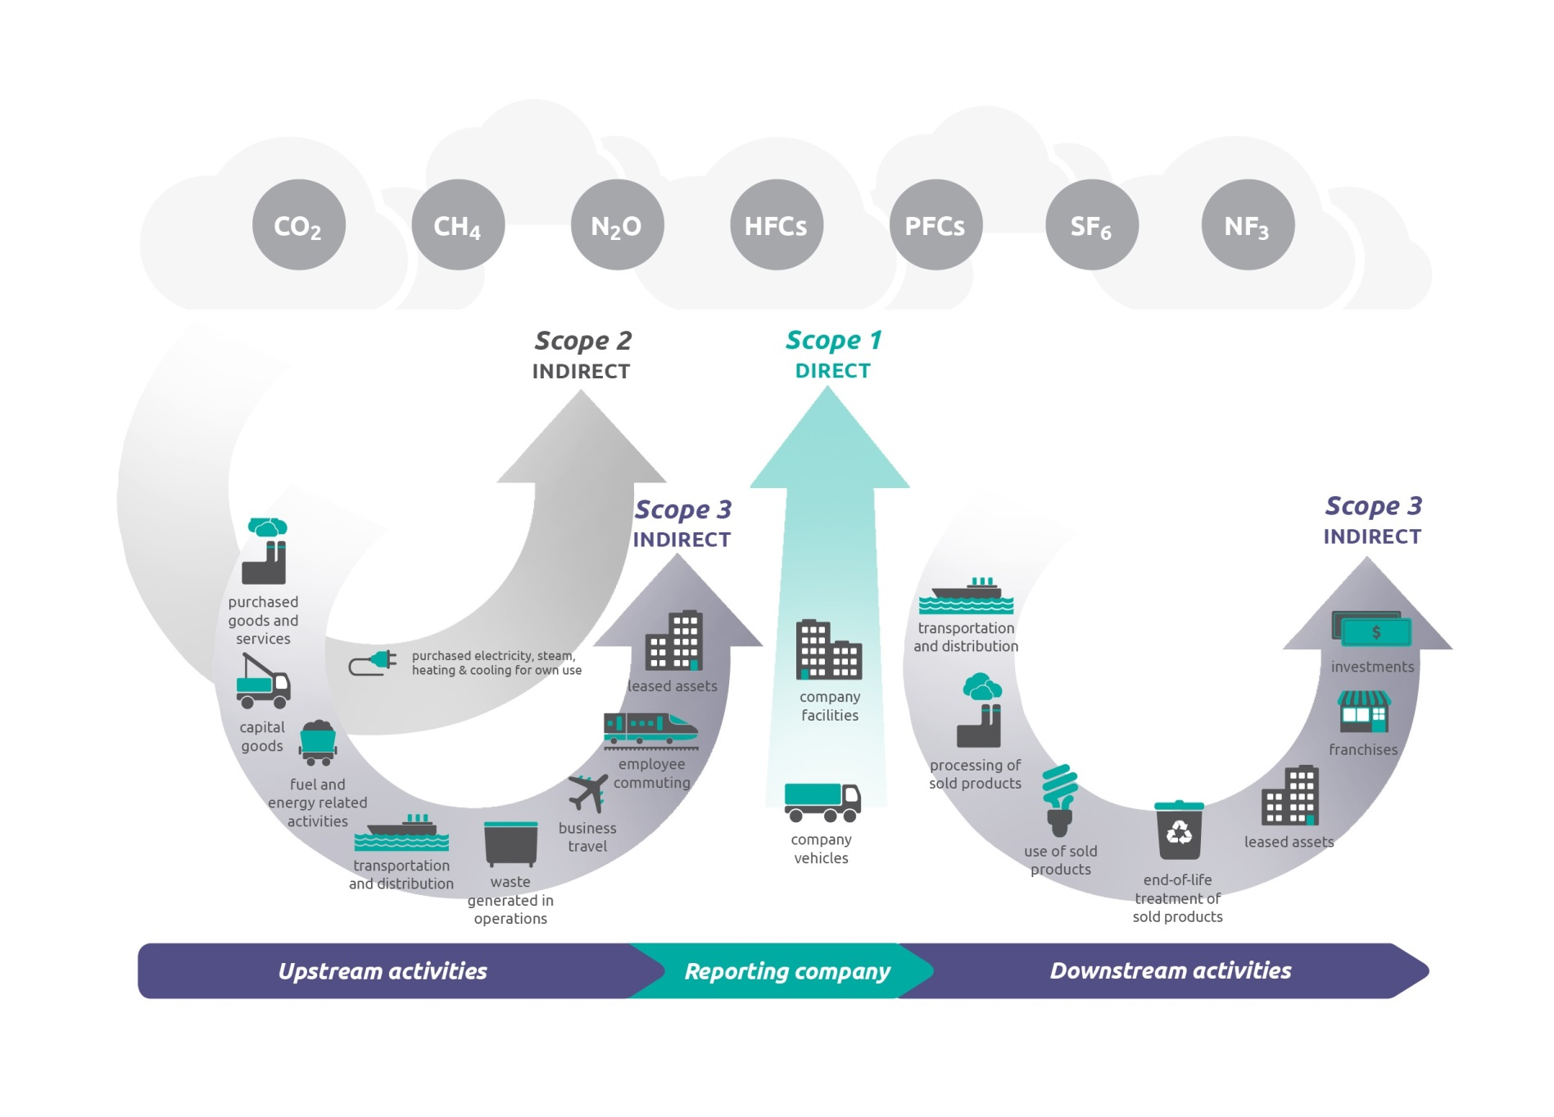
Scopes 1, 2 and 3
Account for and report emissions from each scope separately

Slide 25
Biomass
Emissions from the combustion of biomass
(wood, ethanol, other biofuels, etc.)
CO₂ emissions:
Report separately from Scopes
Because CO₂ is sequestered during growing
N₂O and CH₄
Report as normal within Scopes
Because N₂O and CH₄ not sequestered during growing

Slide 26

Determining Scope
Determined by ownership or control of emission source
NOT determined by type of emission source
The same emissions from energy generation
counted as
Scope 1
by the power plant producing the energy
counted as
Scope 2
by an
office using
the energy
GHGs

Slide 27
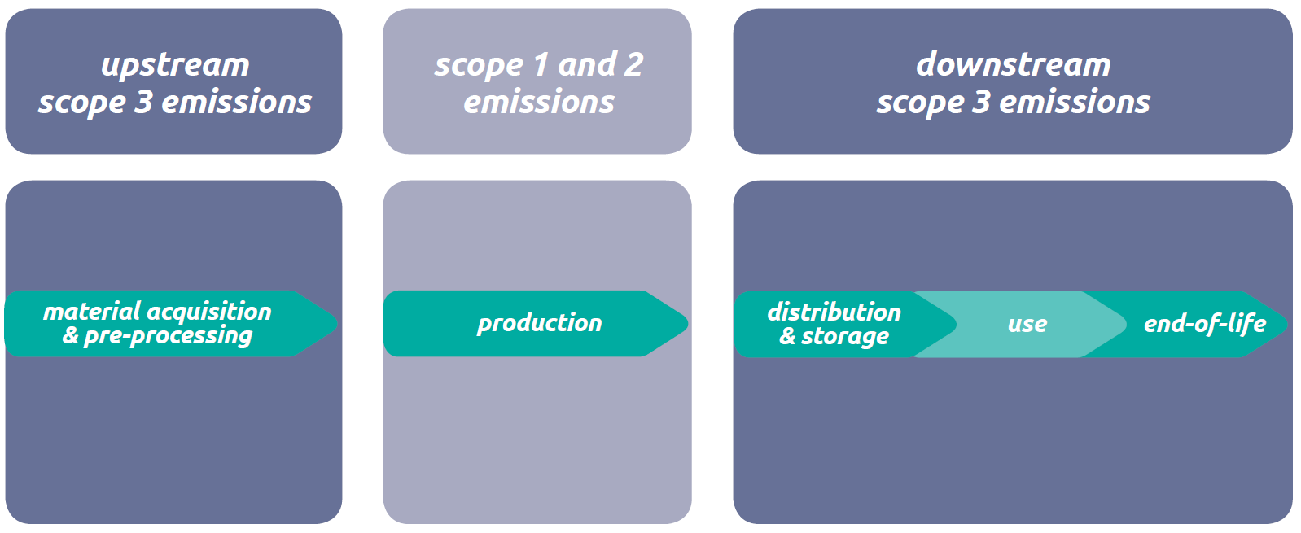
Scopes Across the Value Chain

Slide 28
How will each action affect each scope?
Action | Scope 1 | Scope 2 | Scope 3
Install new thermal power plant on-site so you don’t need to buy power from the grid anymore
Purchase new vehicle fleet instead of outsourcing transportation services
Install new on-site solar power generation plant to replace grid electricity
Install energy efficient lighting at company facilities

Slide 29
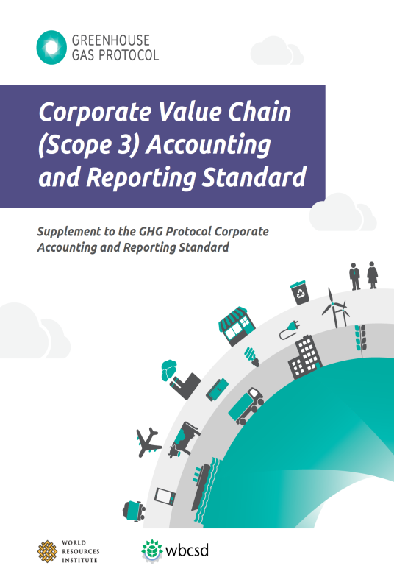
Scope 3: Further Guidance
To account for Scope 3 emissions:
Describe the value chain
Determine which categories are relevant
Identify partners along value chain
Quantify emissions
Remember: Scope depends on who owns/controls emissions source
Consult GHG Protocol Corporate Value Chain (Scope 3) Accounting and Reporting Standard

Slide 30
Special Issue: Electricity Emissions
Consult Corporate Standard when accounting for emissions
from the sale of own-generated electricity
from transmission and distribution of electricity
from electricity purchased for resale to end-users and non-end-users

Slide 31
Leased Assets, Outsourcing and Franchising
Remember consolidation approaches:
Apply selected consolidation approach to leased assets, outsourced activities or franchises
If included in organizational boundary, classify as
If not included in boundary, classify as
1. Equity Share
2. Control
a) Financial Control
b) Operational Control
Scope 1
or
Scope 2
Scope 3

Slide 32
Types of Leased Assets
Finance or capital lease:
Enables lessee to operate an asset
Lessee assumes all risks and rewards of owning asset
Asset considered wholly owned by lessee in financial accounting
Operating lease:
Enables lessee to operate an asset
Lessee assumes NO risks or rewards of owning asset
Any lease that is not capital or finance is an operating lease

Slide 33
Emissions from Leased Assets
LESSEE’S / TENANT’S PERSPECTIVE
 | Capital lease |  | Operating lease
Operational Control Approach | Lessee has control/ownership (S1 or 2)
Financial Control or Equity Share Approach | Lessee has control/ownership (S1 or 2) | Lessee does NOT have control/ownership S3
LESSOR’S / LANDLORD’S PERSPECTIVE
 | Capital lease |  | Operating lease
Operational Control Approach | Lessor does NOT have control/ownership
Financial Control or Equity Share Approach | Lessor does NOT have control/ownership | Lessor has control/ownership

Slide 34
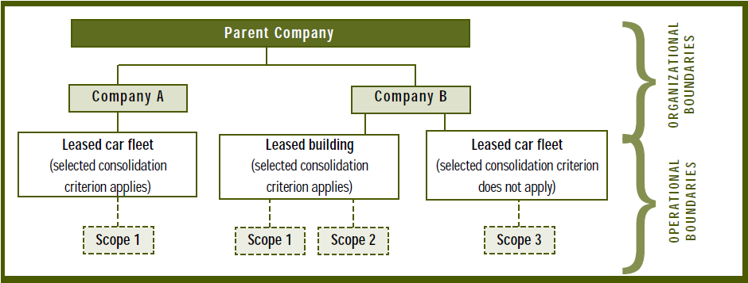
Classifying Emissions from Leased Assets

Slide 35
Double Counting
Occurs when different companies claim ownership of same emissions or reductions
Scopes allow companies to account for emissions along value chain while preventing double-counting
The same emissions will never be reported twice under the same scope (except Scope 3)

Slide 36
Summary
Operational boundaries determine which emissions are included and how they are classified
Apply selected consolidation approach to leased assets, outsourced activities or franchises
Scopes prevent emissions from being double-counted
Scope | Type of Emissions | Reporting
 | direct | mandatory
 | purchase energy | mandatory
 | all other indirect | optional
Scope 1
Scope 2
Scope 3

Slide 37

Further Reading
The Greenhouse Gas Protocol: A Corporate Accounting & Reporting Standard
Chapter 4: Setting Operational Boundaries;
Appendix F: Categorizing GHG Emissions Associated with Leased Assets (http://www.ghgprotocol.org/downloads/calcs/Appendix_F_Leased_Assets.pdf)
Appendix A: Accounting for Indirect Emissions from Purchased Electricity
Appendix D: Industry Sectors and Scopes
The Greenhouse Gas Protocol: Scope 2 Guidance
Hot Climate, Cool Commerce: A Service Sector Guide to Greenhouse Gas Management
Part I, Step 2: Establishing Boundaries
ISO 14064-1
Section 4.2: Operational Boundaries

Slide 38
Additional slides

Slide 39
Types of contractual instruments
The market-based Scope 2 approach is applicable to a wide range of contractual instruments, not just those specifically linked with green power or even renewable energy. They include:
Energy attribute certificates (GOs, RECs)
Direct contracts such as power purchase agreements (PPAs), where other instruments or energy attribute certificates do not exist
Supplier-specific emission rates
Residual mix (e.g., the emissions rate left after the three other contractual information items are removed from the system)

Slide 40
Pros and cons of the two Scope 2 calculation methods
 | Pros | Cons
Location-based method | Reflects actual generation & distribution | No incentive to reflect purchases or influence supply Only means of reducing scope 2 emissions is via consumption Less relevant for making purchasing decisions
Market-based method | Better reflects risks & opportunities associated with supplier portfolios More relevant for making purchasing decisions | Voluntary purchasing may not impact market (but see quality criteria)

